Slide 1

Information Security
Dr. Naji Shukri Alzaza
Associate Prof. of Mobile technology University of Palestine http://najishukri.wordpress.com
December 2020
Notes:
<number>

Slide 2
Module 6
2
Secure Design Principles
Dr. Naji Shukri Alzaza :: Information Security
Notes:
<number>

Slide 3
Defense Models
3
Every network security implementation is based on some kind of model, whether clearly stated as such or assumed.
For example, organizations that use firewalls as their primary means of defense rely on a perimeter security model, while organizations that rely on several different security mechanisms are practicing a layered defense model.
Every security design includes certain assumptions about what is trusted and what is not trusted, and who can go where.
Understanding of which defense model is being used, can make a security infrastructure more effective and applicable to the environment it is meant to protect.
Dr. Naji Shukri Alzaza :: Information Security

Slide 4
Defense Models ..
4
There are two approaches you can take to preserve the confidentiality, integrity, availability, and authenticity of electronic and physical assets such as the data on your network:
Build a defensive perimeter around those assets and trust everyone who has access inside.
Use many different types and levels of security controls in a layered defense-in-depth approach.
Dr. Naji Shukri Alzaza :: Information Security

Slide 5
Lollipop Model
5
The most common form of defense, known as perimeter security, involves building a virtual (or physical) wall around objects of value.
Consider the example of a house it has walls, doors, and windows to protect what’s inside (a perimeter).
Attacker can find a way in either by breaking through the perimeter, or exploiting some weakness in it, or convincing someone inside to let them in.
By comparison, in network security, a firewall is like the house it is a perimeter that can’t keep out all attackers.
Yet the firewall is the most common choice for controlling outside access to the internal network, creating a virtual perimeter around the internal network (which is usually left wide open).
Dr. Naji Shukri Alzaza :: Information Security

Slide 6
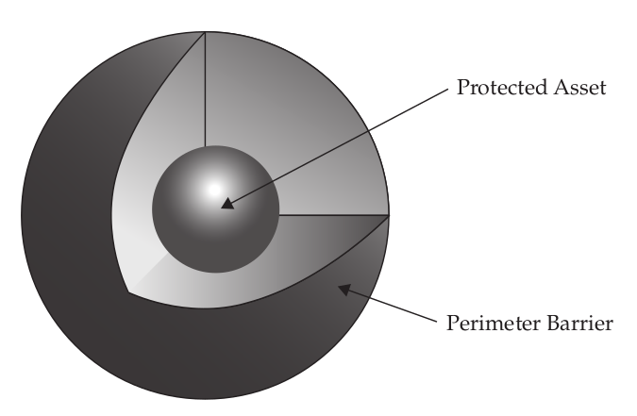
Lollipop Model ..
6
Dr. Naji Shukri Alzaza :: Information Security

Slide 7
Lollipop Model ..
7
This often creates a false sense of security, because attackers can break through, exploit vulnerabilities, or compromise the network from the inside.
One of the limitations of perimeter security is that once an attacker breaches the perimeter defense, the valuables inside are completely exposed.
Another limitation of the lollipop model is that it does not provide different levels of security.
In a house, for example, there may be jewels, private equipment, and cash. These are all provided the same level of protection by the outside walls, but they often require different levels of protection.
On a computer network, a firewall is likewise limited in its abilities, and it shouldn’t be expected to be the only line of defense against intrusion.
Dr. Naji Shukri Alzaza :: Information Security

Slide 8
Onion Model
8
What happens when an attacker gets past the firewall? What happens when a trusted insider, like an employee or a contractor, abuses their privileges?
The onion model addresses these risks.
A firewall alone provides only one layer of protection against threats originating from the Internet, and it does not address internal security needs.
With only one layer of protection, which is common on networks connected to the Internet, all a determined individual has to do is successfully attack that one system to gain full access to everything on the network.
Dr. Naji Shukri Alzaza :: Information Security

Slide 9
Onion Model ..
9
A layered security architecture provides multiple levels of protection against internal and external threats.
Onion model is a better approach of security.
It is a layered strategy, often referred to as defense in depth.
This model addresses the probability of a perimeter security breach/risk occurring. It includes the strong wall of the lollipop but goes beyond the idea of a simple barrier.
A layered security architecture, like an onion, must be peeled away by the attacker, layer by layer, with plenty of crying.
Dr. Naji Shukri Alzaza :: Information Security

Slide 10
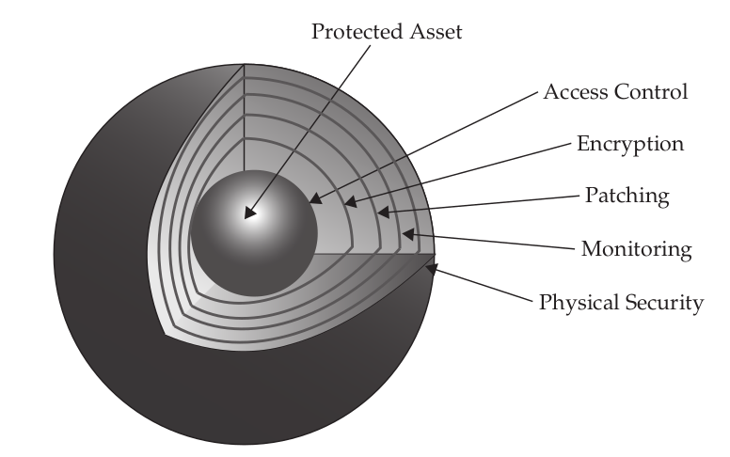
Onion Model ..
10
Dr. Naji Shukri Alzaza :: Information Security

Slide 11
Onion Model ..
<number>
The more layers of controls that exist, the better the protection against a failure of any one of those layers.
Consider a system that allows full access to an account that only uses username/password authentication, without any other security controls.
That system uses only one layer of security, and it is strictly an authentication control.
Anyone who obtains the username and password can gain full access to the system.
If such a system had further layers of security controls that needed to be passed after the username and password authentication, compromising the system would be correspondingly more difficult.
Dr. Naji Shukri Alzaza :: Information Security

Slide 12
Onion Model ..
<number>
The layered security approach can be applied at any level where security controls are placed, not only to increase the amount of work required for an attacker to break down the defenses, but also to reduce the risk of unintended failure of any single technology.
System, network, and application authentication controls can be layered.
Network and system access controls can also be layered.
Encryption protocols can be layered (such as by encrypting first with PGP followed by encrypting with Blowfish or AES).
Audit trails can be layered with the use of local system logs coupled with off-system network activity logs.
System availability controls can be layered by using clustering technology and redundancy. (??)
Dr. Naji Shukri Alzaza :: Information Security

Slide 13
Best Practices for Network Defense
<number>
It only takes one careless end user to infect an entire network.
You must stop malicious mobile code from arriving on the desktop in the first place, close holes, and make sure the users’ computers are appropriately configured.
If they can’t click on malware, run it, or allow it on their computer, you’ve significantly decreased the threat of malicious attack.
There are many countermeasures you can implement to minimize the risk of a successful attack, such as:
Securing the physical environment
Hardening the operating systems
Keeping patches updated
Using an antivirus scanner
Using a firewall
Securing network share permissions
Dr. Naji Shukri Alzaza :: Information Security

Slide 14
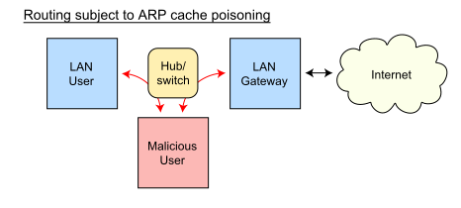
Best Practices for Network Defense ..
<number>
Using encryptions
Securing applications
Backing up the system
Creating a computer security defense plan
Implementing ARP poisoning defenses.
Address Resolution Protocol (ARP) spoofing may allow an attacker to intercept data frames on a network, modify the traffic, or stop all traffic.
Often the attack is used as an opening for other attacks, such as denial of service, man in the middle, or session hijacking attacks.
Dr. Naji Shukri Alzaza :: Information Security

Slide 15


سؤالك قد يفتح آفاقاً جديدة لم تُسْبَر .. أو يطرق أبواباً مغلقة لم تُفتح .. #تأملات_حياة
<number>
Dr. Naji Shukri Alzaza,UX

